Slide 1
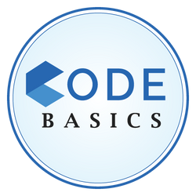












Telangana growth analysis
CREATED BY
Abishek S

Slide 2






Table of Contents
Introduction
Objective
Tools Used
Dashboard Overview
Stamp and Document Registration Analysis
Transportation (Vehicle Sales Analysis)
TS-Ipass (Telangana State Industrial Project Approval and Self Certification System)
Secondary Research

Slide 3
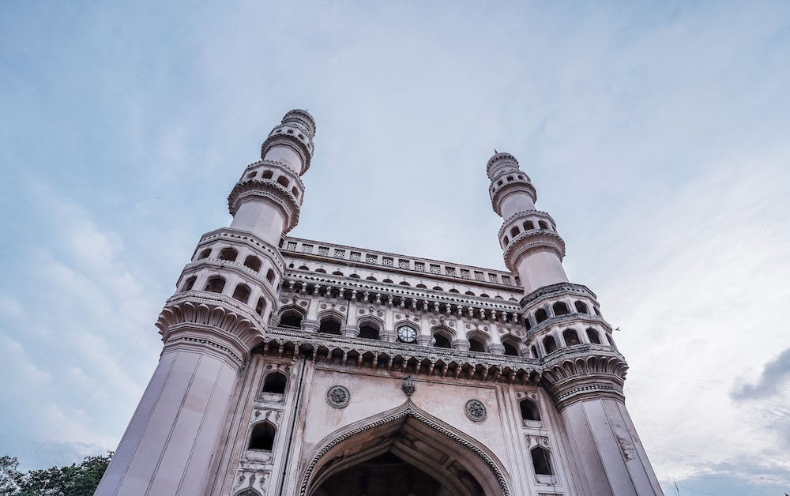





Introduction
Telangana is one of the fastest-growing states in India and one of the states with an open data policy. (They have published all their data online).
Peter Pandey is an aspiring data analyst looking for a project with real-time data to add to his portfolio. He wanted to analyze Telangana’s growth among different sectors quantitatively and provide useful Insights to the Telangana government that would help them to make data-informed decisions that would further support the growth of the state.
Peter Pandey began this project by drafting some of the key objectives for this analysis.

Slide 4




Objective
Explore Stamp Registration, Transportation and Ts-Ipass Datasets.
Understand their attributes, categories and time period.
Analyze trends and patterns within each department.
Identify growth opportunities and areas needing attention.
Find correlation among these departments and report the overall growth of the state through insights and relevant visuals such as shape maps.

Slide 5



Tools Used
Power BI
Power Query
Microsoft PowerPoint

Slide 6

Dashboard Overview

Slide 7
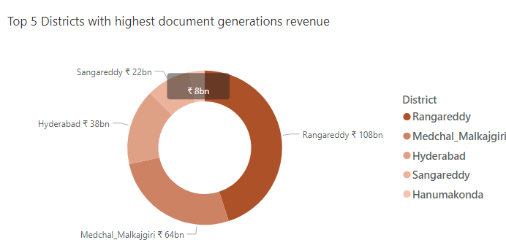



Stamp and Document Registration
1. How does the revenue generated from document registration vary across districts in Telangana? List down the top 5 districts that showed the highest document registration revenue growth between FY 2019 and 2022.
South west region contributes high document registration revenue.
Top 5 districts that showed the highest document registration revenue growth between FY 2019 and 2022:
Rangareddy (108 billion)
Medchal Malkajgiri (64 billion)
Hyderabad (38 billion)
Sangareddy (22 billion)
Hanumakonda (8 billion)

Slide 8
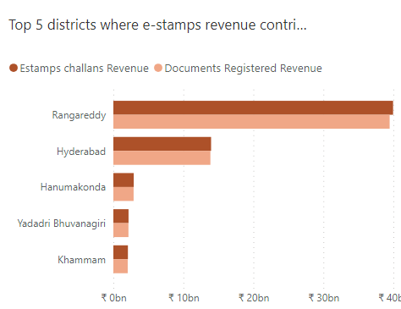
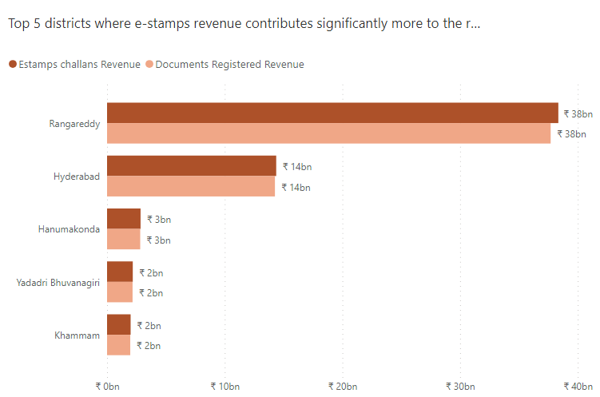
Stamp and Document Registration
2. How does the revenue generated from document registration compare to the revenue generated from e-stamp challans across districts? List down the top 5 districts where e-stamps revenue contributes significantly more to the revenue than the documents in FY 2022?
Document Registrations outnumbers Estamp challan registrations by 25%.
Top 5 districts where e-stamps revenue contributes significantly more to the revenue than the documents in FY 2022:
Rangareddy (with a gap of 651 million)
Hyderabad (with a gap of 108 million)
Khammam (with a gap of 30 million)
Hanumakonda (with a gap of 29 million)
Yadadri Bhuvanagiri (with a gap of 17 million
DAX → Gap = [Total_estamps_challans_rev]-[Total_documents_registered_rev]

Slide 9
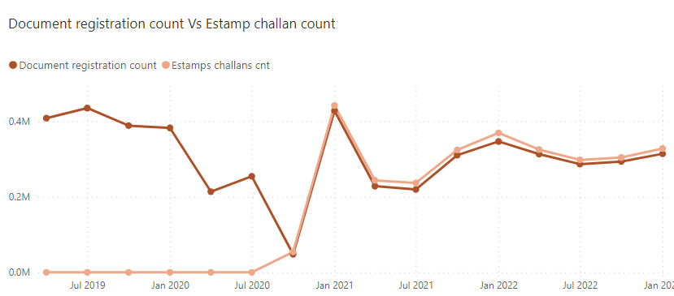
Stamp and Document Registration
3. Is there any alteration of e-Stamp challan count and document registration count pattern since the implementation of e-Stamp challan? If so, what suggestions would you propose to the government?
Document registration count was doing good before the launch of Estamp challans.
After the introduction of Estamp, from 2021 Estamp generated high revenue.
There’s a significant drop in the revenue of both Estamps and Document registration on May 2021(COVID Lockdown)
Recommendation:
Government should try to promote Estamp further, since they exhibit Positive trend over the period of time.

Slide 10
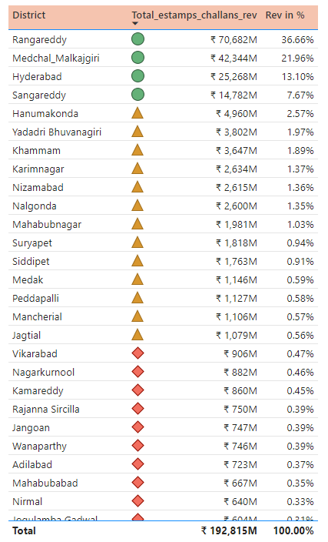
Stamp and Document Registration
4. Categorize districts into three segments based on their stamp registration revenue generation during the fiscal year 2021 to 2022.
Conditional Formatting based on Stamp registration revenue :
🔶 - 0 to 1 billion
- 1 to 10 billion
🟢 - Above 10 billion
Top 3 Districts with high revenue:
Rangareddy
Medchal Malkajgiri
Hyderabad
Bottom 3 Districts with Low revenue:
Kumurambheem Asifabad
Mulugu
Warangal

Slide 11
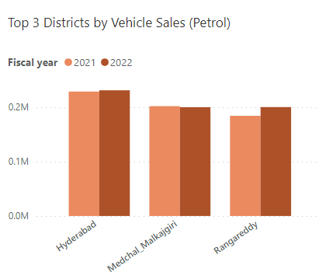
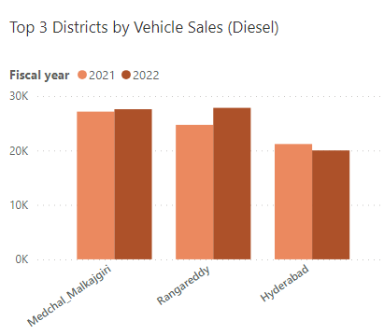
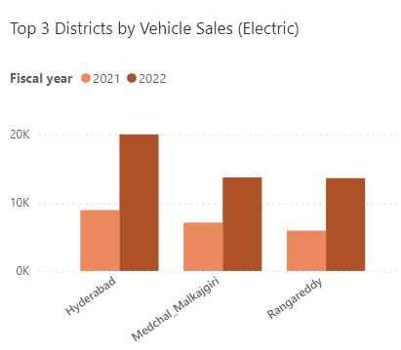
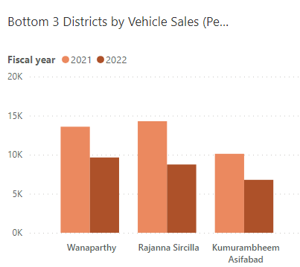
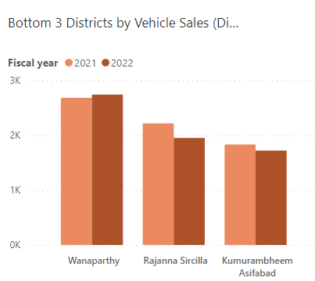
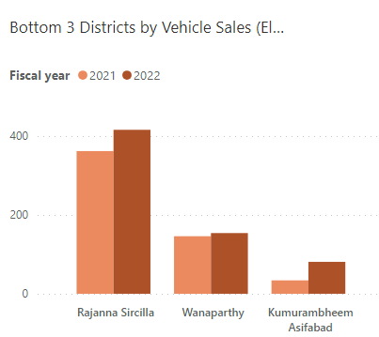
Transportation (Vehicle Sales Analysis)
1. List down the top 3 and bottom 3 districts that have shown the highest and lowest vehicle sales growth during FY 2022 compared to FY 2021? (Consider and compare categories: Petrol, Diesel and Electric)
PETROL TYPE
DIESEL TYPE
ELECTRIC TYPE

Slide 12
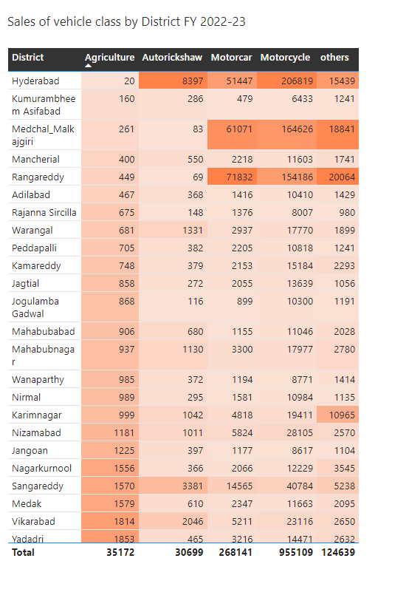
Transportation (Vehicle Sales Analysis)
2. How does the distribution of vehicles vary by vehicle class (MotorCycle, MotorCar, AutoRickshaw, Agriculture) across different districts? Are there any districts with a predominant preference for a specific vehicle class? Consider FY 2022 for analysis.
Districts with a predominant preference for a specific vehicle class:
Agriculture: Nalgonda (7.39% ), Siddipet (6.93%), and Suryapet (6.22%)
Autorickshaw: Hyderabad (27.35% ), Sangareddy (11%), and Khammam (8.76%)
MotorCar: Rangareddy (26.79%), Medchal Malkajgiri (22.78%), and Hyderabad (19.19%)
Motorcycle: Hyderabad (21.65% ), Medchal Malkajgiri (17.24%), and Rangareddy (16.14%)
Domination of vehicle classes:
Motorcycle > MotorCar > Agriculture > Autorickshaw
https://nalgonda.telangana.gov.in/agriculture/

Slide 13
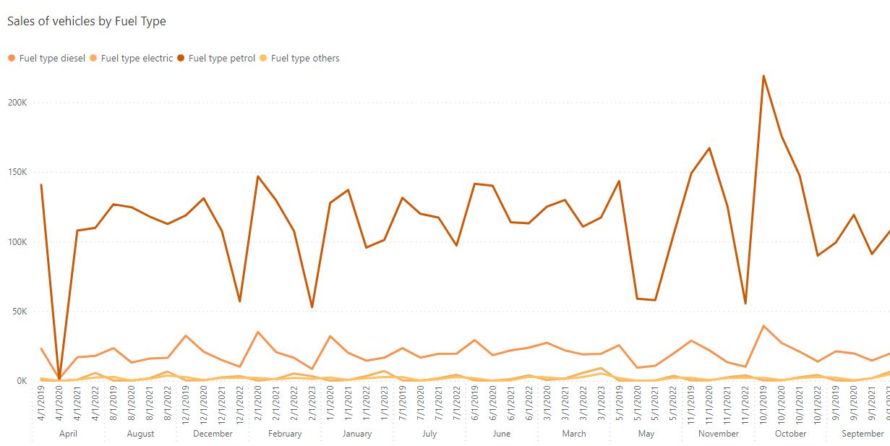
Transportation (Vehicle Sales Analysis)
3. Investigate whether there is any correlation between vehicle sales and specific months or seasons in different districts. Are there any months or seasons that consistently show higher or lower sales rate, and if yes, what could be the driving factors? (Consider Fuel-Type category only)
We can clearly see a spike in vehicle sales around October(COVID period and festival times) while lowest in April month especially Petrol type.
Quarter 3 shows the best performance in vehicle sales overall.
https://www.newindianexpress.com/states/telangana/2020/dec/28/telangana-vehicle-sales-go-through-the-roof-in-october-november-2242070.html
https://timesofindia.indiatimes.com/city/hyderabad/pandemic-or-not-vehicle-sales-robust-in-hyd-districts/articleshow/84126112.cms

Slide 14
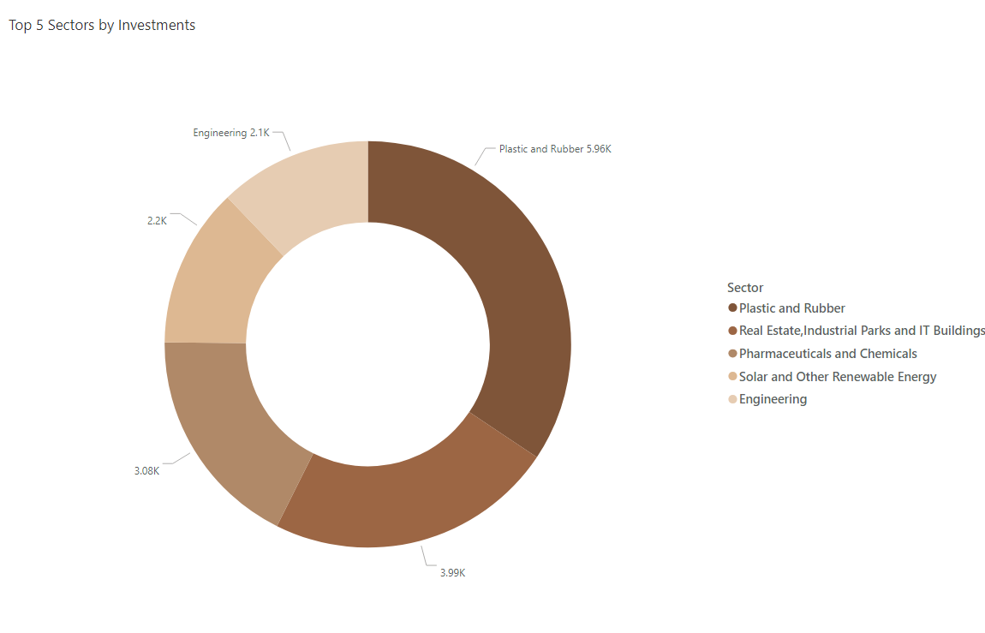
Industrial Project Approval and Self Certification System
1. List down the top 5 sectors that have witnessed the most significant investments in FY 2022.
Top 5 sectors that have witnessed the most significant investments in FY 2022:
Plastic and Rubber
Pharmaceuticals and Chemicals
Real Estate, Industrial Parks and IT Buildings
Solar and Other Renewable Energy
Engineering.

Slide 15
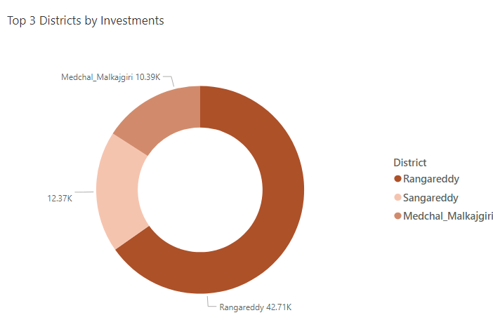
Industrial Project Approval and Self Certification System
2. List down the top 3 districts that have attracted the most significant sector investments during FY 2019 to 2022? What factors could have led to the substantial investments in these particular districts?
Top 3 districts that have attracted the most significant sector investments during FY 2019 to 2022:
Rangareddy (42,706 Cr)
Sangareddy (12,366 Cr)
Medchal Malkajgiri (10394 Cr)
Factors could have led to the substantial investments in these particular districts:
The land cost is economical
Population
Skilled labours

Slide 16
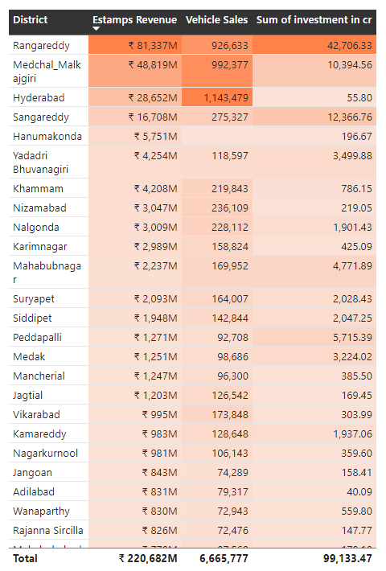
Industrial Project Approval and Self Certification System
3. Is there any relationship between district investments, vehicles sales and stamps revenue within the same district between FY 2021 and 2022?
Relationship between district investments, vehicles sales and stamps revenue within the same district between FY 2021 and 2022:
We can clearly see that Rangareddy does well in all the three areas, while Hyderabad and medchal Malkajgiri exhibits good Estamps revenue and Vehicle sales.

Slide 17
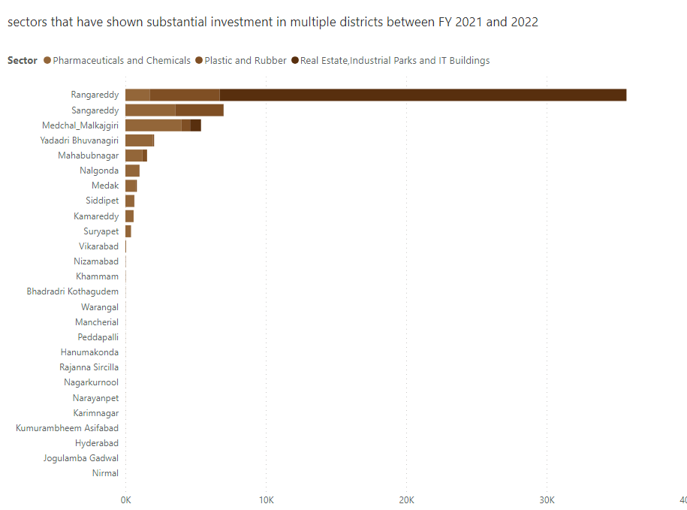
Industrial Project Approval and Self Certification System
4. Are there any particular sectors that have shown substantial investment in multiple districts between FY 2021 and 2022?
Sectors that have shown substantial investment in multiple districts between FY 2021 and 2022:
Pharmaceuticals and chemicals
Plastic and Rubber
Real Estate,Industrial Parks and IT Buildings

Slide 18
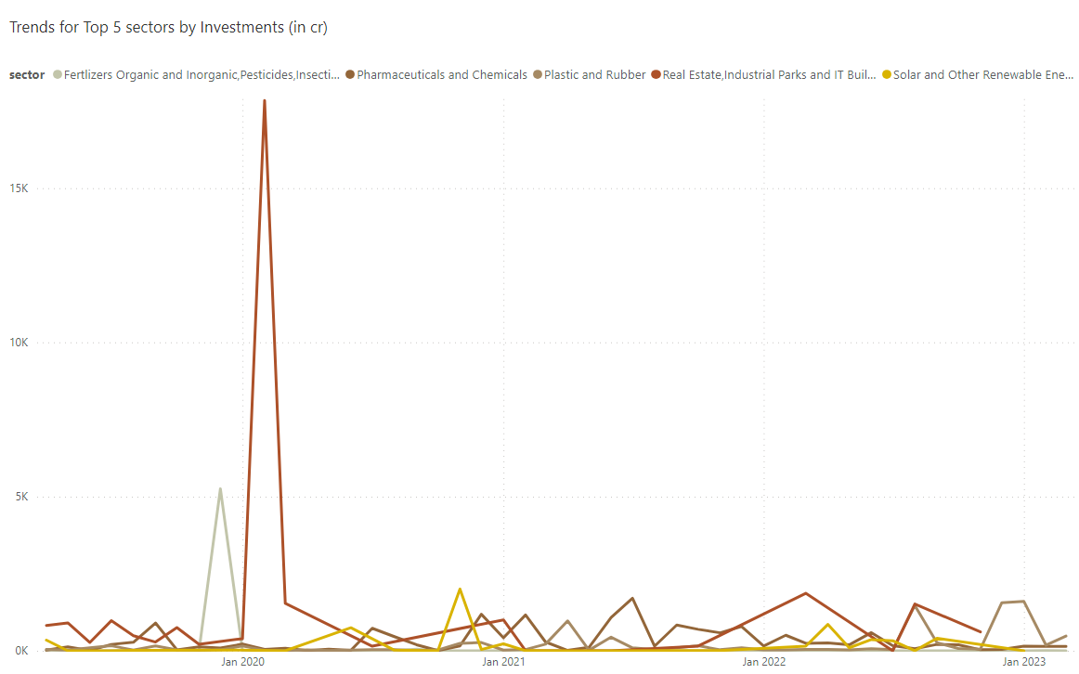
Industrial Project Approval and Self Certification System
5. Can we identify any seasonal patterns or cyclicality in the investment trends for specific sectors? Do certain sectors experience higher investments during particular months?
Fertilizers Organic and inorganic, pesticides, Insecticides and other related – DECEMBER (97.3%)
Pharmaceuticals and Chemicals – JULY (17.7 %)
Plastic and Rubber – December(20.2 %) and January(18.6%)
Real Estate, Industrial parks and IT buildings – February(60%)
Solar and other Renewable Energy – (35.6%)

Slide 19
Secondary Research
1. What are the top 5 districts to buy commercial properties in Telangana? Justify your answer.
Hyderabad: It is a major economic and commercial hub considered as home to many multinational companies, IT firms, and startups. The city has a well-developed infrastructure and is well-connected to other parts of India and the world.
Rangareddy: This district is home to several IT parks and commercial complexes, including Hitech City, Gachibowli, and Shamshabad. It is also home to the Rajiv Gandhi International Airport.
Medak: This district is located on the outskirts of Hyderabad and is home to several industrial and manufacturing units. It is also home to the Pharma City, which is a hub for pharmaceutical companies.
Warangal: This district is located in the northern part of Telangana and is a major commercial center for the region. It is home to several textile mills and other industries.
Karimnagar: This district is located in the northeastern part of Telangana and is a major agricultural center. It is also home to several sugar mills and other agro-based industries.
https://timesproperty.com/news/post/have-you-considered-investing-in-land-for-higher-roi-blid3209?offset=1

Slide 20
Secondary Research
1. What are the top 5 districts to buy commercial properties in Telangana? Justify your answer.
Factors considered (Justification):
Location: When buying commercial real estate, location is one of the most crucial factors to take into account. The building should be situated in a desirable area that is easily accessible and connected.
Budget: Prior to beginning your commercial real estate investment, you should establish a budget. This will assist you in reducing your options and locating a property that suits your requirements.
Demand, Economic growth and Infrastructure

Slide 21



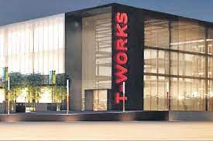
Secondary Research
2. What significant policies or initiatives were put into effect to enhance economic growth, investments, and employment in Telangana by the current government? Can we quantify the impact of these policies using available data?
TS-iPASS: The Telangana State Industrial Project Approval and Self-Certification System (TS-iPASS) is a single-window clearance system for industrial projects. It has made it much easier and faster for businesses to set up and operate in Telangana.
TS-bPASS: The Telangana State Building Permission Approval and Self-Certification System (TS-bPASS) is a similar system for building approvals. It has also made it much easier and faster to construct buildings in Telangana.
Rythu Bandhu: The Rythu Bandhu scheme is a direct cash transfer scheme for farmers. It provides farmers with financial assistance to purchase inputs for their crops. This has helped to improve agricultural productivity and incomes in Telangana.
Mission Kakatiya: Mission Kakatiya is a program to restore and rejuvenate over 46,000 irrigation tanks in Telangana. This has helped to improve irrigation infrastructure and boost agricultural production.
24x7 Free Power to Agriculture: The Telangana government provides 24x7 free power to farmers. This has helped to reduce the cost of cultivation and improve the profitability of agriculture.
T-Hub: T-Hub is a global innovation hub that supports startups and entrepreneurs. It has helped to create a vibrant startup ecosystem in Telangana.
T-Works: T-Works is a co-working space and accelerator program for startups. It provides startups with access to mentorship, funding, and other resources.
Skill Development: The Telangana government is investing heavily in skill development programs. This is helping to create a skilled workforce that can meet the needs of the growing economy.

Slide 22




Secondary Research
2. What significant policies or initiatives were put into effect to enhance economic growth, investments, and employment in Telangana by the current government? Can we quantify the impact of these policies using available data?
The results of the Telangana government's efforts to enhance economic growth, investments, and employment have been significant :
Economic growth: Telangana has emerged as one of the fastest-growing states in India. The state's economy has grown at an average rate of 11% per year since its formation in 2014.
Investments: Telangana has attracted significant investment in recent years. In 2022-23, the state attracted over Rs. 20,000 crore in investment, which created over 70,000 jobs.
Employment: Telangana has created over 3 million jobs since its formation. The state's unemployment rate has fallen from 10.1% in 2014 to 7.6% in 2023.

Slide 23
Secondary Research
Top 5 Insights and Recommendations
Estamp Revenue surpassed the document registration revenue since its launch exhibiting a positive trend, therefore can be a potential dominant in upcoming days.
Recommendation: Government should try to promote Estamp challans and their benefits further, it has high revenue generating capacity.
Rangareddy, Hyderabad and medchal malkajgiri tops in all the three analysis, indicates that it has the best infrastructure and symbolizes economical growth overall.
Recommendation: This three districts alone generates a good amount of revenue, therefore further investment and development strategies can be followed making them the strongest revenue generating districts for Telangana.
Certain sectors experience higher investments during particular months, for example we can see that Vehicle sales skyrocketed in the month of October.
Recommendation: Such times can be utilized by companies so that they can attract their customers by promoting discounts and new innovations in their respective sectors.

Slide 24
Secondary Research
Top 5 Insights and Recommendations
We can see that the sales of Electric Vehicles increases gradually, particularly in the FY 2022. Electric vehicles are more efficient, and that combined with the electricity cost means that charging an electric vehicle is cheaper than filling petrol.
Recommendation: Government can promote the Electric vehicles by providing subsidies and other attractive benefits. Building charging stations across the districts.
Low revenue generating districts such as Mulugu, Warangal and Kumurambheem Asifabad should be noted and necessary measures should be taken to increase their revenue generating capacity.
Recommendation: Implementing strategies such as taking a survey to understand what lacks and which needs improvement. Assigning task force to improve infrastructure of those districts etc.

Slide 25

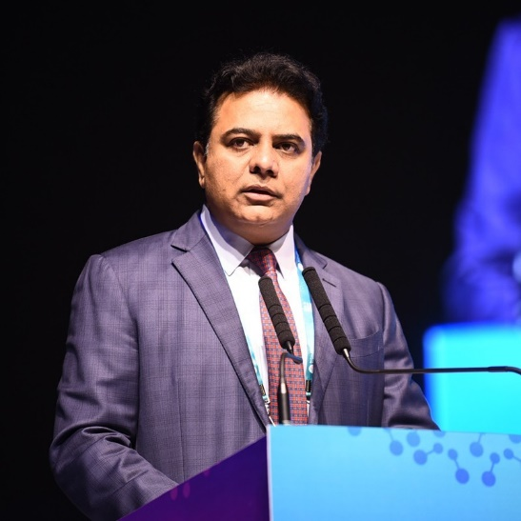
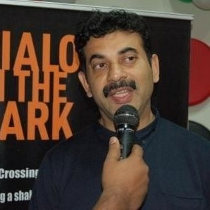
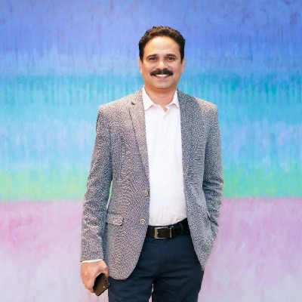
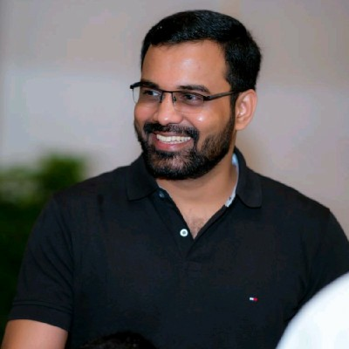




Thank You
Kalvakuntla Taraka Rama Rao / KTR
Minister for IT, Industries and Municipal Administration
Jayesh Ranjan
Principal Secretary, Information Technology (IT) & Industries and Commerce (I&C), Government of Telangana
Dileep Konatham
Director at Government of Telangana
Venu Panjarla
Open Data Telangana
CREATED BY
Abishek S

Slide 26
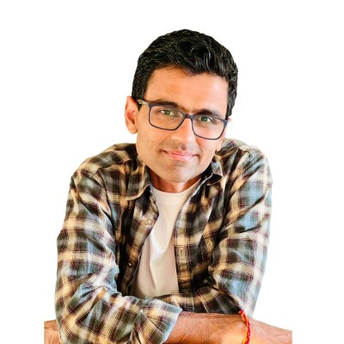

Thank You
Dhaval Patel
Founder, Codebasics
Hemanand Vadivel
Co-Founder, Codebasics
CREATED BY
Abishek S

